Slide 1


Attendance QR (Week 8, Session 2)

Slide 2
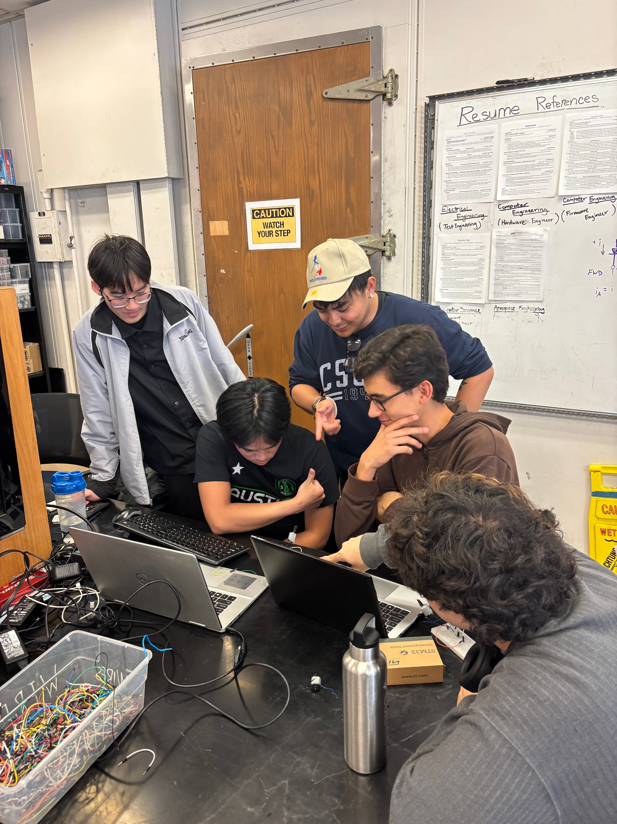
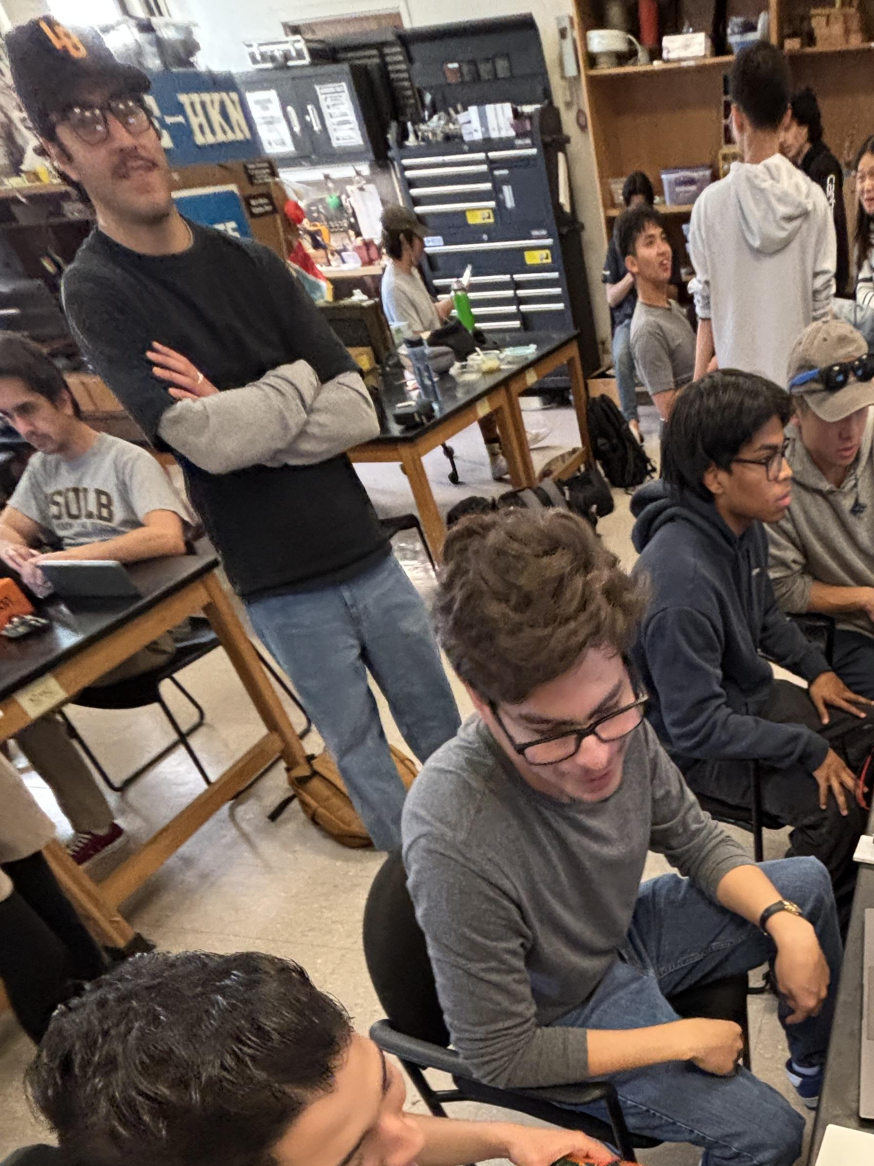
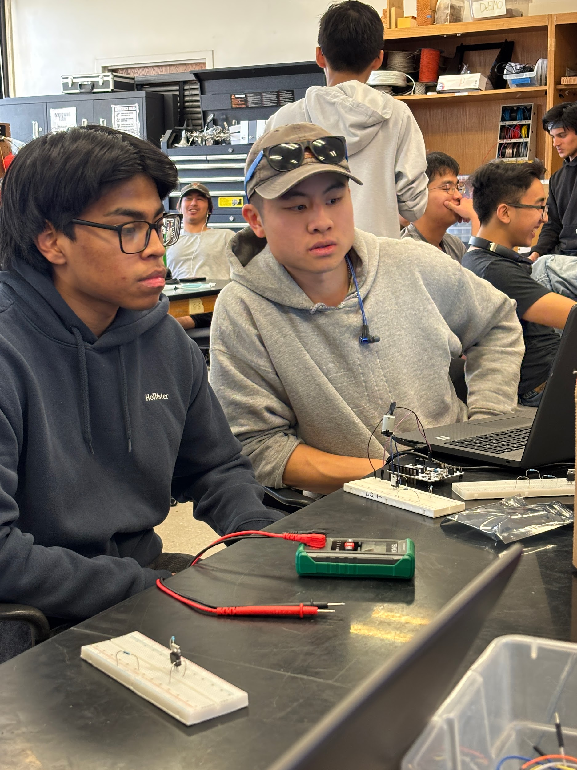
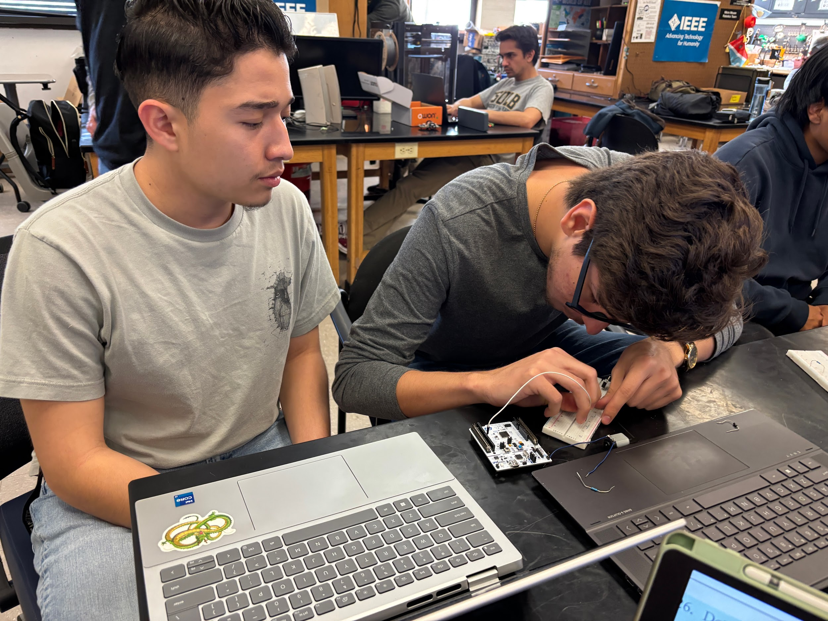
Thanks for joining SOPHEE!

Slide 3
Meeting 8
Final Project
IEEE - CSULB Branch

Slide 4

Agenda
Review
Final Project!

Slide 5
Review
STM32 Peripherals (Week 4)
Power/GND, GPIO, Pull-Up/Pull-Down resistors, A-to-D/D-to-A converters, timers, interrupts, communication
Demo: PWM to Analog
Embedded Programming (Week 5)
Language hierarchy, HAL library, code files, flash memory, SRAM, transistors
Demo: MOSFET Motor Driver
Embedded Systems (Week 2)
ICs, MPUs, MCUs, dev/breakout boards, NUCLEO board, embedded systems
Demo: Blinky, PuTTY, Traffic Light
STM32 Design Requirements (Week 3)
Datasheeting, regulation, filtering, oscillators, bypass/bulk capacitors, clock, programming/debugging
Demo: RC circuit, Flickering Light, DMM, Oscilloscope

Slide 6
Review (cntd)
Part Types/Sourcing (Week 6)
PCB creation process, part packages, part distributors
Demo: Schematic Creation
SPI Communication Protocol (Week 7)
SPI features, SPI lines (CS, SCLK, MOSI, MISO)
Demo: PCB Layout Creation, Manufacturer Exports

Slide 7
Demo: Temperature Sensor Control Loop
What is needed?
Software:
STM32CubeIDE
Link:
BMP280 Datasheet
Hardware:
NUCLEO-F401
Breadboard
BMP280 Breakout Board
Wires
DMM
Hardware
DC Supply
DC Motor
Fan
N Channel MOSFET
Diode (anti-flyback)

Slide 8
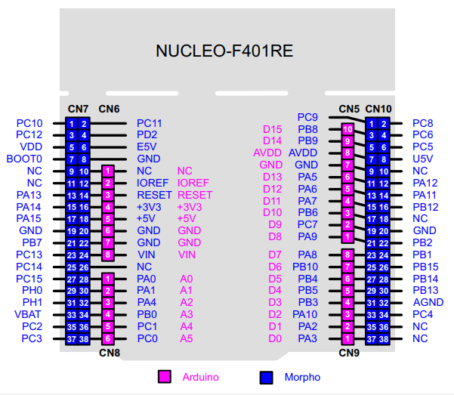
Demo

Slide 9
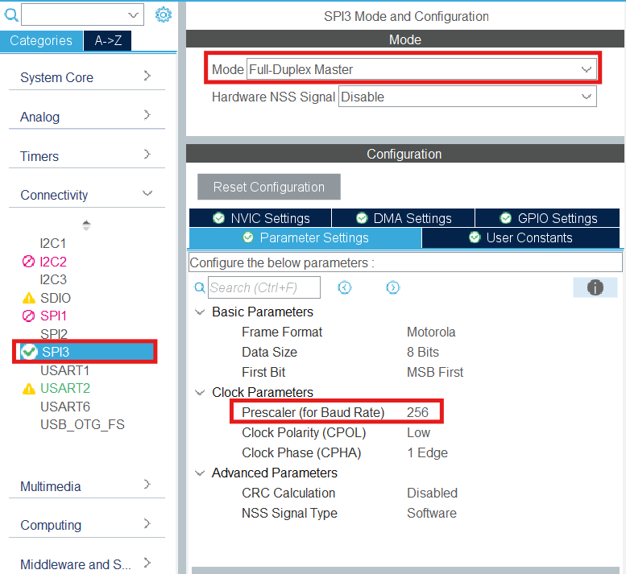
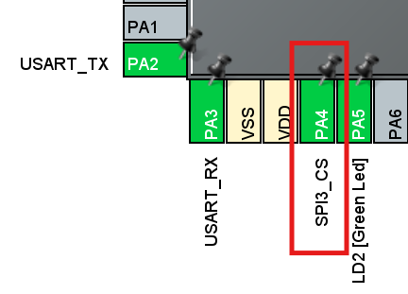
Demo
Create a new STM32 project
Enable SPI3 —----->
Make PA4 pin “GPIO Output” (This will be our CS pin):

Slide 10
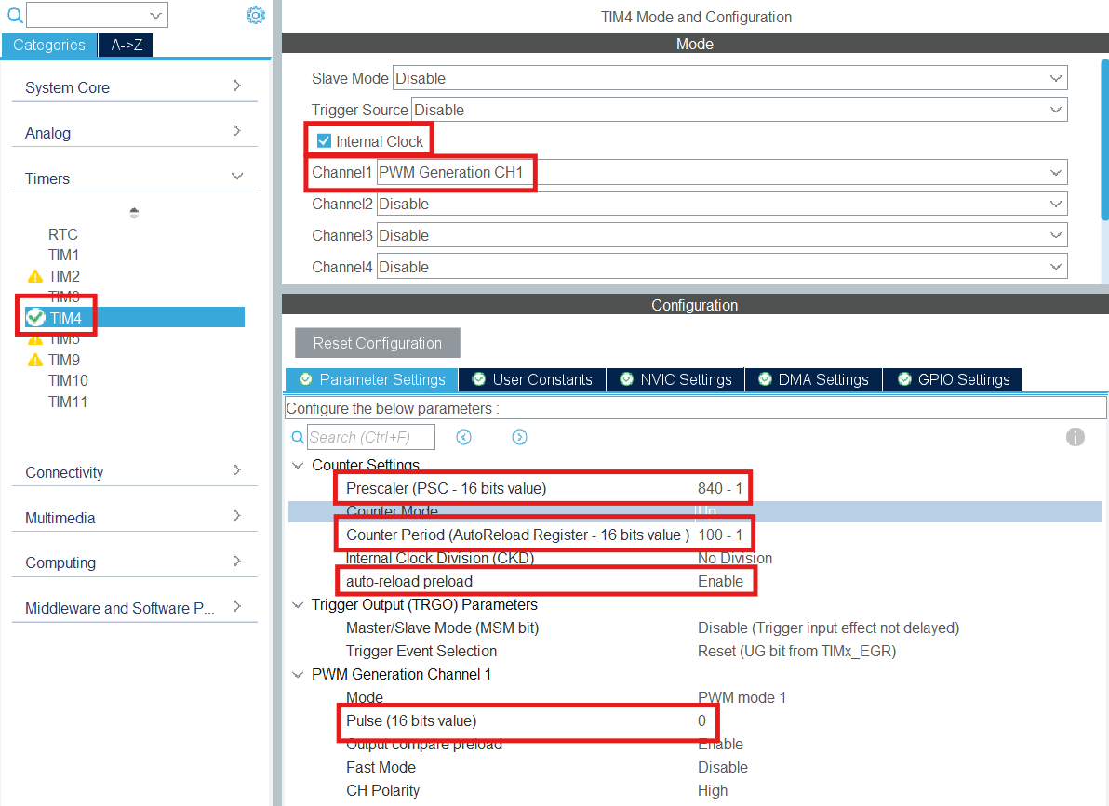
Demo
Make PB6 a PWM Output (This will be our motor control pin):

Slide 11
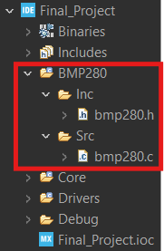
Demo
Download the .c and .h files
These files make up a BMP280 SPI driver
Drivers allow for low-level hardware control along with high-level functions for ease of use
Create a new “BMP280” folder with subfolder Inc and Src to hold the driver files:
Allow new files to be compiled:
Project -> Properties -> C/C++ General -> Path Symbols
In Includes tab add the “/BMP280/Inc” directory
In Source Location tab add “/BMP280” folder

Slide 12
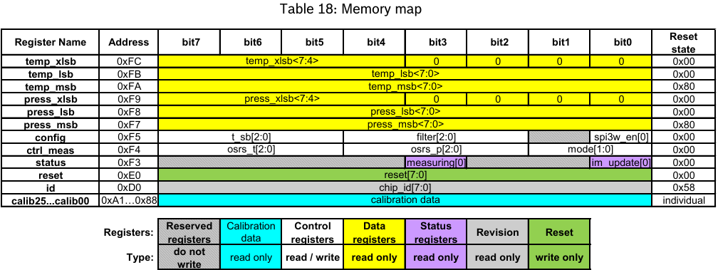
Demo
Open the “BMP280.h” file and enter the missing register addresses
From datasheet (You have to search yourself):

Slide 13
Demo
In main.c file starting around line 22:
/* Private includes ----------------------------------------------------------*/
/* USER CODE BEGIN Includes */
#include "bmp280.h"
#include <stdio.h>
/* USER CODE END Includes */
In main.c file starting around line 64:
/* Private user code ---------------------------------------------------------*/
/* USER CODE BEGIN 0 */
int _write(int file, char *ptr, int len)
{
HAL_UART_Transmit(&huart2, (uint8_t*)ptr, len, HAL_MAX_DELAY);
return len;
}
/* USER CODE END 0 */
#include "bmp280.h" will allow us the use the driver functions within our main.c file
#include <stdio.h> will allow us to use the printf function to output data to a console
int _write() function will convert printf function into a UART transmission

Slide 14
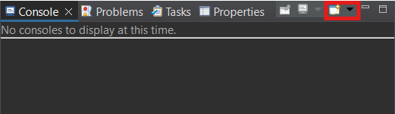
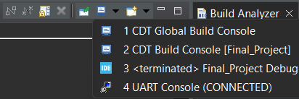
Demo
To printf to STM32CubeIDE console:
Click the console dropdown —--------------->
Select “3 Command Shell Console”
Connection Type: Serial Port
Encoding: UTF-8
Select “New”
Serial Port matches STLink COM port
Baud Rate matches UART baud rate (115200bps)
When you run the program, printf statements will now go to the created console
Click “Display Selected Console” dropdown to select your console —--------------------------------------------->

Slide 15
Demo
bmp280_init() will initialize the BMP280 sensor making sure that the device is detected and setting up the correct bit sequence for the control and config registers.
HAL_TIM_PWM_Start will start the PWM signal on timer 4 channel 1 (Pin PB6).
The temperature and pressure variables will hold the temperature (in Celsius) and atmospheric pressure (in hPa) returned from the sensor.
In main.c file starting around line 106:
/* USER CODE BEGIN 2 */
bmp280_init(); // Initialize BMP280 sensor
HAL_TIM_PWM_Start(&htim4, TIM_CHANNEL_1); // Start PWM signal
int32_t temperature;
uint32_t pressure;
/* USER CODE END 2 */

Slide 16
Demo
In main.c file starting around line 113:
/* Infinite loop */
/* USER CODE BEGIN WHILE */
while (1)
{
bmp280_read_data(&temperature, &pressure);
printf("Temperature: %ld.%02ld°C", temperature / 100, temperature % 100);
printf(" Pressure: %ld.%02ld hPa\r\n", pressure / 100, pressure % 100);
if ((temperature / 100) > 30) {
TIM4->CCR1 = 50; // Fan running at 50% duty cycle when above 30C
}
else {
TIM4->CCR1 = 0; // Fan stops when below 30C
}
/* USER CODE END WHILE */
/* USER CODE BEGIN 3 */
}
Temperature and pressure data is read and printed to the console.
If the temperature is above 30 degrees Celsius, the fan turns on, and if not it turns off.

Slide 17
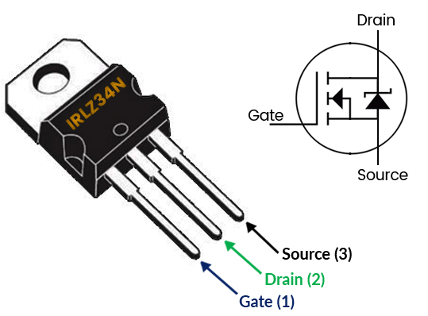
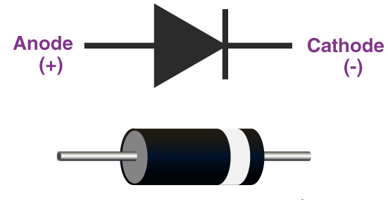
Demo

Slide 18
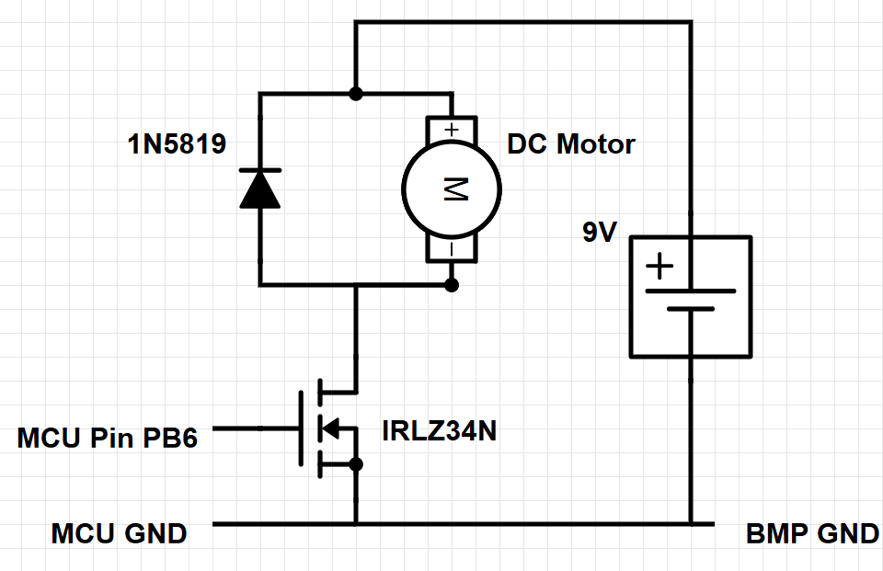
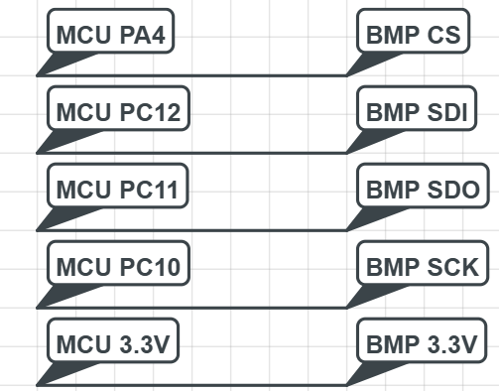
Demo
Follow the circuit schematic:
Run the code
Check the console you create to see the temperature and pressure
Use soldering iron to heat up the sensor and activate the cooling fan
Closed loop system since input (temperature reading) and output (fan speed) affect each other
Vin

